Slide 1
Types of Characters
Pelfrey

Slide 2
1. Flat characters
These are the guys that run around in the background of a movie or just deliver the pizza to the protagonist
Character that is shallow, not very developed and basically a prop.
What you see is what you get
They exist to show the characteristics and help develop the round characters.

Slide 3
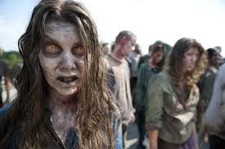
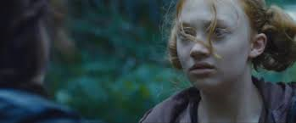
Flat Examples

Slide 4
2. Round characters
If you need more than one word to describe them, they are round
A character that has flaws, strengths, ideas, theories, and is basically a well rounded person.
Most like real people
Can be developed through dialogue, reactions to conflicts, internal struggles, past experiences, etc.
Most of the protagonists are round

Slide 5
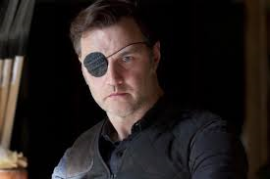
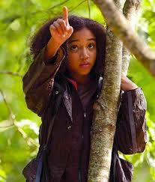
Round Examples

Slide 6
3. Static character
A character that doesn’t change (in an internal way) throughout the story
Static characters can still have lots of personality, but they just can’t change.
Please note, they can have a physical change (break a leg, grow old), but as in life, it is what is in the inside that counts.
For example, just because someone in a book or story gets cancer and loses their hair, they are still considered static if they were a jerk both before and after the experience.

Slide 7
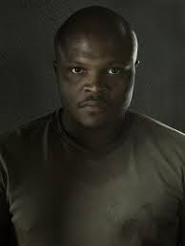
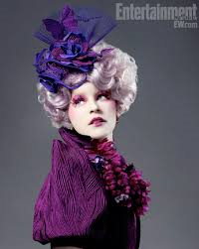
Static examples

Slide 8
4. Dynamic characters
A character that has some type of internal (ex. Emotional) change during the story
The majority of your protagonists will be dynamic, because that is what people relate with the most.
These guys face a challenge and are changed by it.

Slide 9
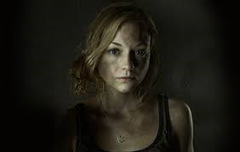
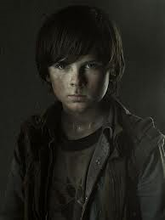
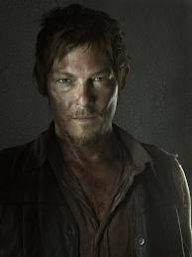
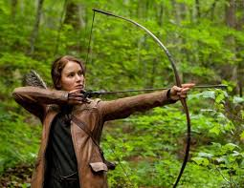
Dynamic Examples

Slide 10
Important question
Can a character be both static and dynamic?
NO
Can a character be both dynamic and round?
YES
Can a character be both flat and round?
NO
Can a character be both static and flat?
YES

Slide 11
5. Foil characters
A foil character is the near opposite of a protagonist
A writer included a foil character to show the protagonist’s characteristics
Examples:
Batman vs. Superman
Hans Solo vs. Luke Skywalker (original Star Wars)

Slide 12
Foil characters continued
Foil characters can oppose the protagonists through physical features, dialogue and behavior.
A foil character can also be a sidekick or enemy
Examples:
Sherlock Holmes and Dr. Watson

Slide 13
We will be examining foil characters in more detail later
Any comments, questions or concerns now?

Slide 14
Time for the activity!
Identify four different types of characters: one static, dynamic, round, and flat.
Make sure to explain to be how each fits the type of character you say it is.

